Slide 1
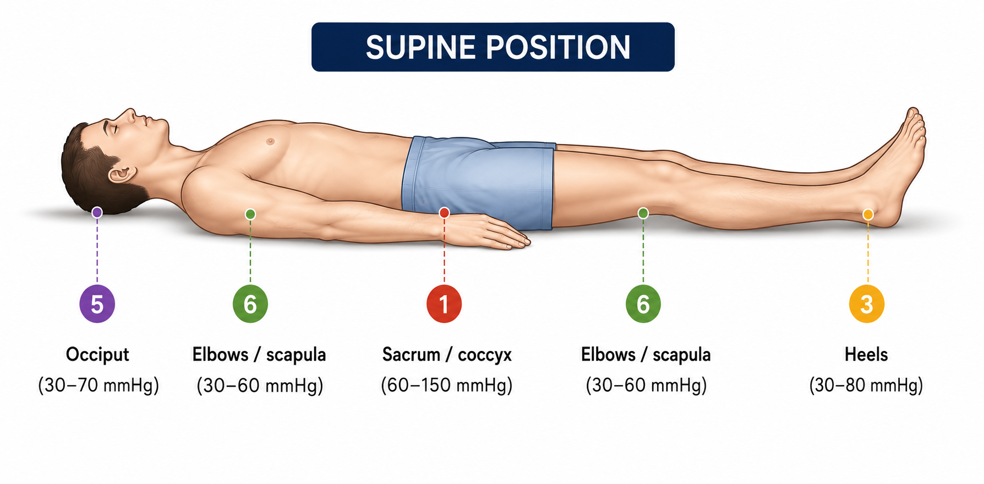
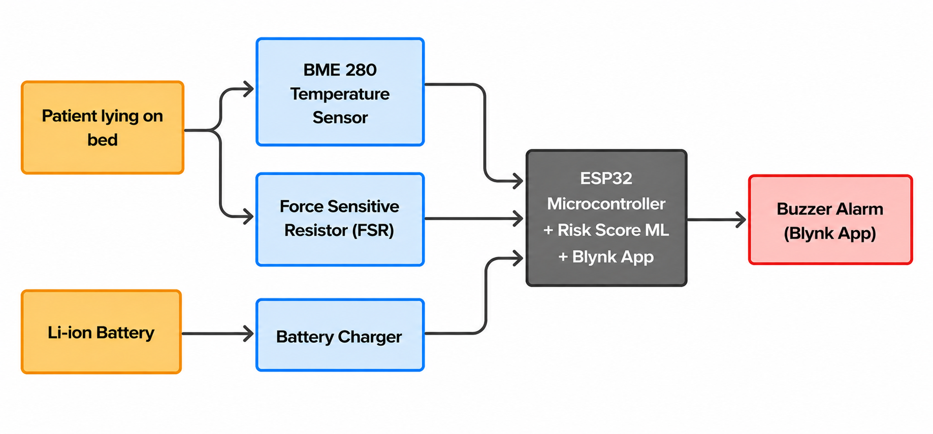
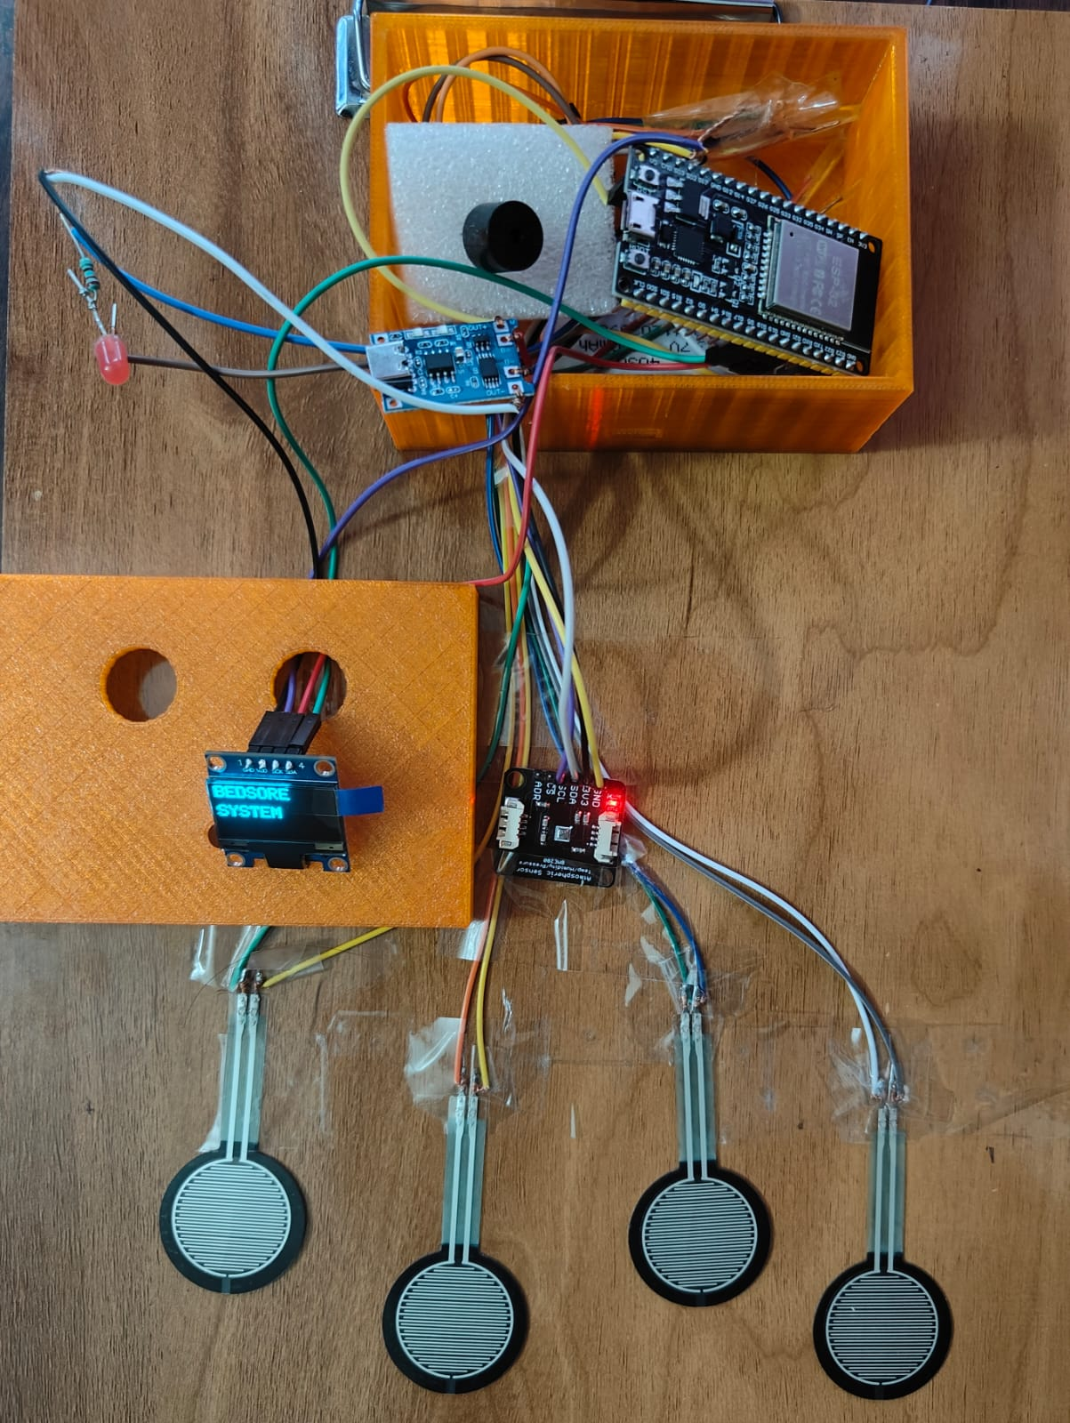
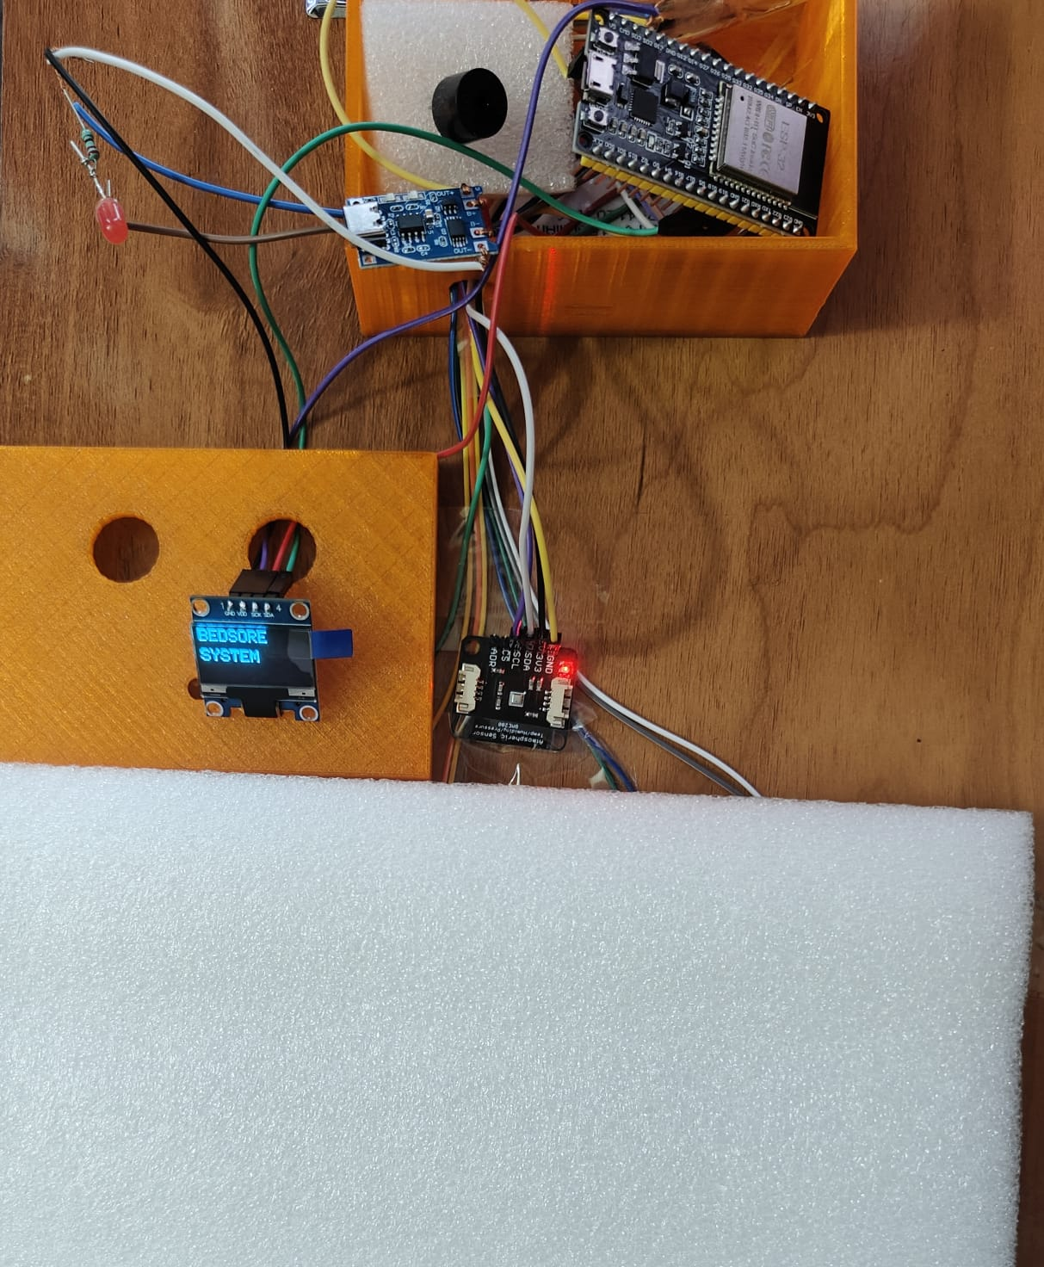
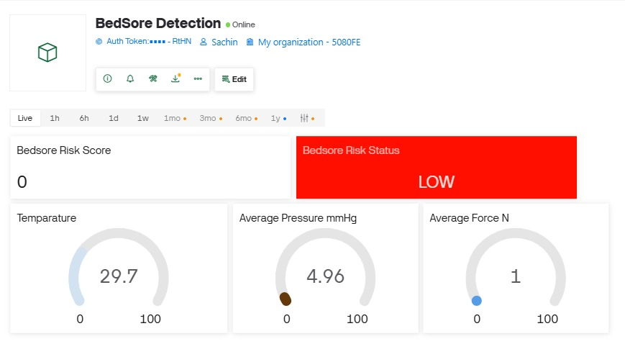

Smart Pressure and Temperature-based system for early detection of bedsore risk
Sachin B. Khaire, Sanket N. Patil, Siva Arivoule S A, Ramoji Rao D
JBMSHST IIT Guwahati, Assam, India
Motivation
Bed sores, also known as pressure ulcers or decubitus ulcers, are localized injuries to the skin and underlying tissue that occur due to prolonged pressure, most commonly over bony prominences.
Bedridden patients are at high risk of pressure ulcers due to prolonged pressure and heat buildup.
Early tissue damage often occurs before visible skin changes.
Current monitoring relies on manual checks and caregiver observation.
There is a need for a low-cost, real-time bedsore risk detection system
State of the art
Alternating pressure air mattresses: KosmoCare Air Bed for Bedsore prevention (Mostly High Cost)
Smart sensor-based pressure monitoring:
SENSOMATT Pressure Monitoring Sensor Sheet, XSENSOR
Fore Site PT patient turn system (restricted to multi-speciality hospitals)
Research: IoT embedded prototypes exist
In need of smart, low-cost, and real-time monitoring systems
Core technological idea
Prolonged interface pressure detected by the FSR sensors and temperature changes detected by BME280 is converted from sensor voltage into force (N) using pressure–force conversion principles.
When the calculated force and exposure duration exceed the predefined risk threshold, the system activates the buzzer and generates a high-risk alert through the Blynk IoT monitoring console.
Implementation and Achievements
Arterial Capillary Closure Pressure: 32 mmHg (Baseline)
Average Indian Sacral Area: 100–105 cm²
Force = Pressure x Area (Pressure to force conversion)
$$RiskScore=\left(F×45\right)+\left(T×20\right)+\left(D×25\right)+\left(S×10\right)$$
Critical Parameters:
Pressure (mmHg) | Local Skin Temperature Change (ΔT) | Risk Level | Interpretation
< 32 | ΔT < 0.5°C | Low | Normal pressure & microclimate
32–40 | ΔT 0.5–1.0°C | Moderate | Early tissue stress possible
40–60 | ΔT 1.0–1.2°C | High | Reduced perfusion risk
> 60 or prolonged >32 | ΔT > 1.2°C | Critical | High bedsore formation risk
Final Prototype
Blynk Interface
Reflection & Conclusion
Development of skills in hardware prototyping, embedded programming, and system integration
Successful design concept of a low-cost bedsore risk detection system
Sensor placement and threshold calibration and risk model prediction may need improvement
The system has potential for early bedsore risk detection in bedridden patients
Outlook
  Improvement of wearable cushion design for patient comfort
  Long-term reliability training and validation of the monitoring system
References
[1] NPUAP, Pressure Ulcer Prevention Guidelines, 2019
[2] Minteer et al., Pressure Ulcer Monitoring Platform (PUMP), Journal of Wound Care, 2019
[3] A. Memari et al./ Transactions on Machine Intelligence 3(2) (2020) 101-110

